Slide 1
Exploring Student’s Behavior: An Exploratory Data Analysis in Python
Mohammed Ali Arsalan M 22MDT0099
Mohamed Affan M 22MDT0088
Mohammed Saqui T 22MDT0098

Slide 2
Objective
Analyze student behavior using EDA techniques
Explore relationships between variables and identify trends for the collected data
Draw assumptions about student activities based on the analysis
Provide valuable information for educators and institutions to understand their students better
Develop strategies to improve academic performance and student engagement based on the analysis

Slide 3
Abstract
Educational data analytics is used to study the data which is available in the educational institutions to analyze behavior of modern students. In this project we use Exploratory Data Analysis (EDA) techniques to analyze student behavior and gain insights into their study habits, academic performance, hobbies, financial situation, travel time, and social media usage, etc. In our project we will be performing descriptive statistics and data visualization techniques using Python packages such as Matplotlib, Numpy, Seaborn, Pandas to clean, Visualize and identify patterns and provides new insights into the problem. The results provide valuable information for educators and institutions to develop strategies to improve academic performance and student engagement.

Slide 4
Literature Review
[1] Now-a-days the amount of data stored in educational database increasing rapidly. These databases contain hidden information for improvement of students’ performance. Educational data mining is used to study the data available in the educational field and bring out the hidden knowledge from it.The results provide steps to improve the performance of the students who were predicted to fail or promoted. After the declaration of the results in the final examination the marks obtained by the students are fed into the system and the results were analyzed for the next session. The comparative analysis of the results states that the prediction has helped the weaker students to improve and brought out betterment in the result
[2] It represents an important step for the university and its further performance using non-traditional learning methods, due to the fact that most of the lectures carried out at the university are still done in a traditional way (lecturer-centred). In the virtual-class, more efforts should be directed towards decreasing frustrations by improving motivation and interactivity. Motivation could be strengthening by creating a sense of community and by building trust between students

Slide 5
Literature Review
[4] This paper discusses the use of data mining techniques to improve student retention. The authors used clustering algorithms to group students based on their behavior and identify factors that contribute to student retention.
[5] This study used EDA techniques to analyze college students' time use and found that students spend most of their time on academic activities and leisure activities, with little time spent on employment, volunteering, or household activities.

Slide 6
Work Plan
S.NO | Task | Start Date | End Date
1 | Data Collection | 17-03-2023 | 31-03-2023
2 | Data Cleaning & Analysis | 04-01-2023 | 15-042023
3 | Data Visualization | 16-04-2023 | 30-04-2023
4 | Final Presentation | After Cat-2 | -

Slide 7
References
[1] Rajeev Gandhi, B. (2012). Anticipation for Performance Improvement of Students using Machine Learning Approach. Artificial Intelligent Systems And Machine Learning, 4(5), 296-301. Retrieved from https://www.ciitresearch.org/dl/index.php/aiml/article/view/AIML052012007
[2] Rebeka Lukman, and Majda Krajnc. “Exploring Non-Traditional Learning Methods in Virtual and Real-World Environments.” Journal of Educational Technology & Society, vol. 15, no. 1, 2012, pp. 237–47. JSTOR, http://www.jstor.org/stable/jeductechsoci.15.1.237. Accessed 22 Mar. 2023.
[3] "Data mining and student retention: a case study" by M. Romero and E. Zafra.
[4] "An Exploratory Data Analysis of College Student Time Use" by Tom W. Archibald and David H. Feldman (2008)

Slide 8
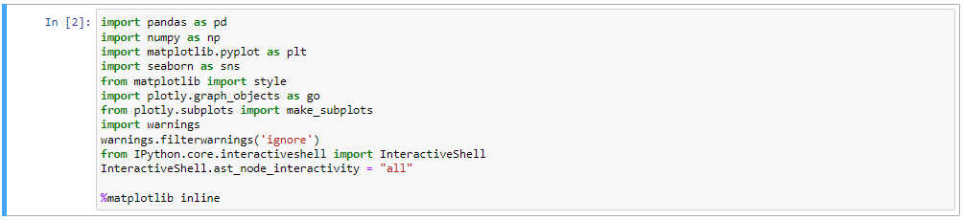
Importing the libraries
Below are some of the necessary python libraries used in performing analysis and visualization.

Slide 9
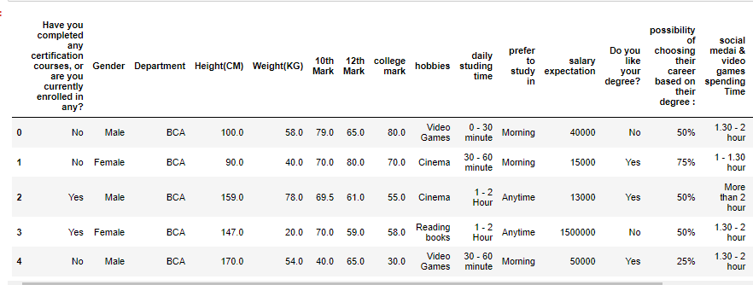
Importing the data set

Slide 10
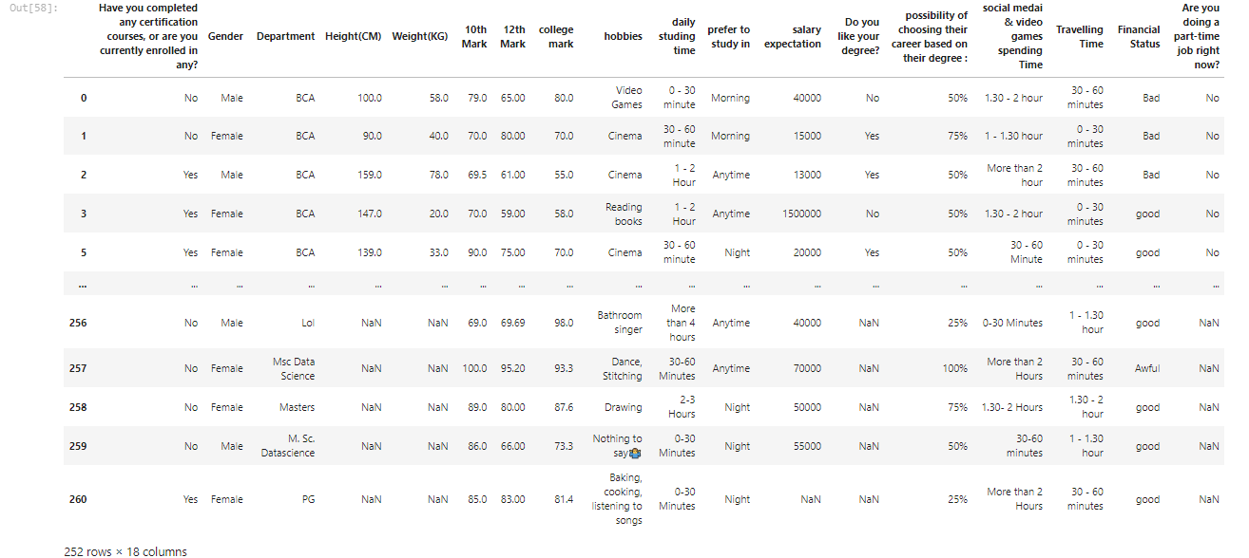
Data Pre-Processing
Filtering the data based on scores > 35 in school & college

Slide 11
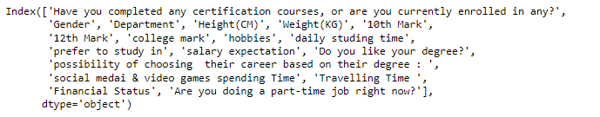
Variables Present in dataset
Below are some of the columns available in our dataset.

Slide 12
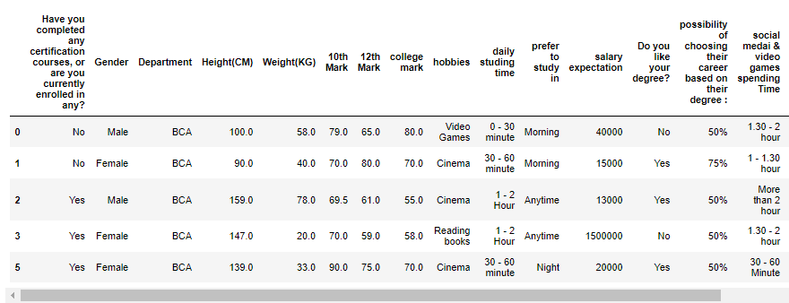
Droping the variable which is least important for our analysis
In our dataset 'Are you doing a part-time job right now?‘ column doesn’t provide any useful information so we are deleting that column.

Slide 13
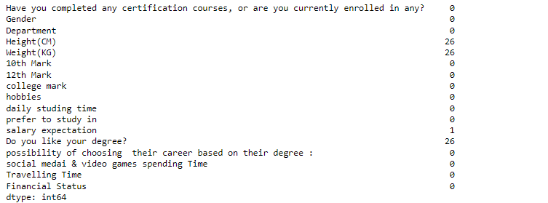
Handling Missing Values
From the above information, we can see that our dataset contains missing values.

Slide 14
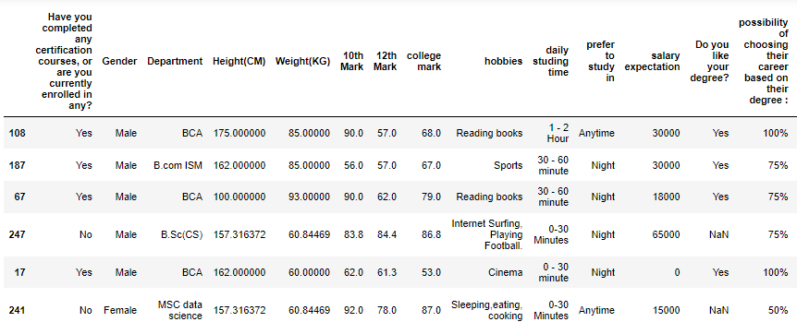
Handling Missing Values
fill the missing values of height & weight using mean method

Slide 15
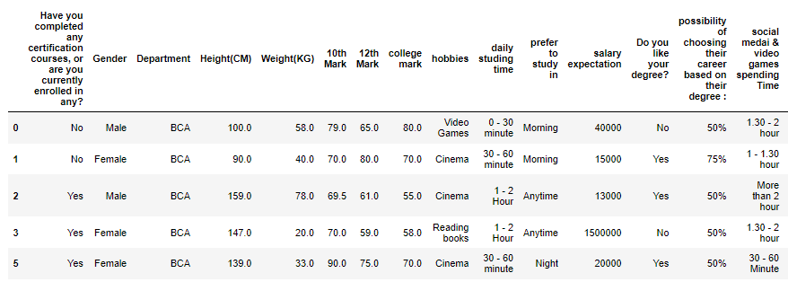
Handling Missing Values
filling the values of ‘Do you like your degree’ column with most no. of occurrences

Slide 16
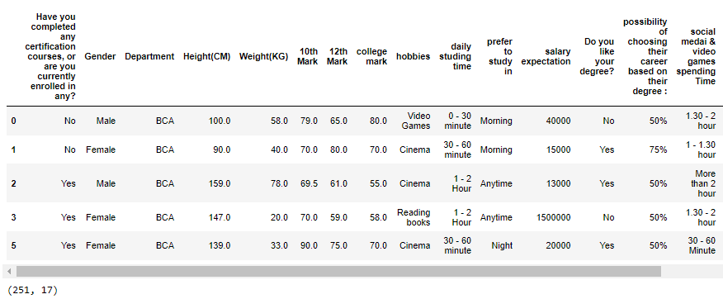
Handling Missing Values
We are deleting the remaining missing values using dropna() method.

Slide 17
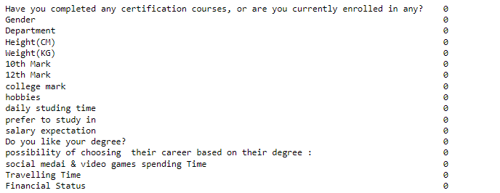
Handling Missing Values
After handling the missing data now our dataset doesn’t contain any null values.

Slide 18
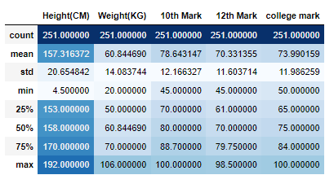
Descriptive Statistics:
We can use the describe() method so that we can be able to see the percentiles, mean, std, max, and count of the given dataset.

Slide 19
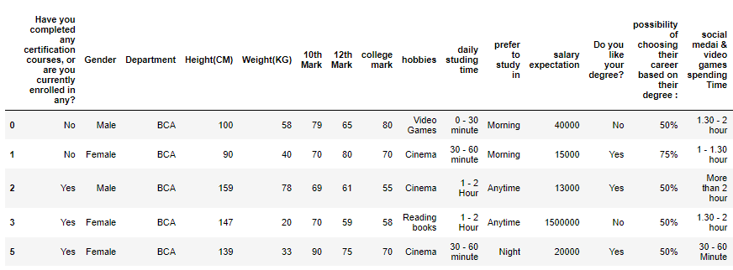
Descriptive Statistics:
Converting the data type from float into integer for better readability.

Slide 20
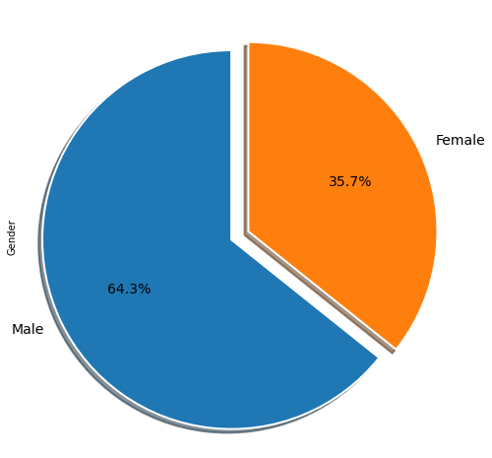
Data Visualization:
Male count vs Female count
Female
Male
From the above information, we could conclude that the total count of male students is 162 and the total count of female students is 90.

Slide 21
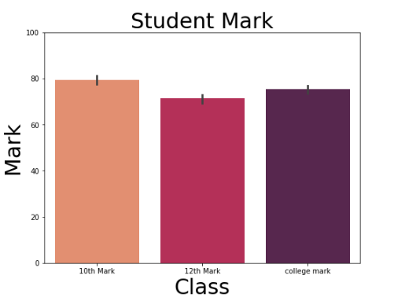
Data Visualization:
Average Student Mark in 10th standard,12th standard, and college

Slide 22
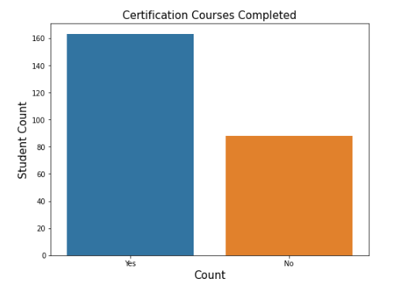
Data Visualization:
Certification plays an important role in getting selected for corporate jobs.So let's see how many students have completed any certification courses.
According to the data above, more then 160 students have finished a certification course.

Slide 23
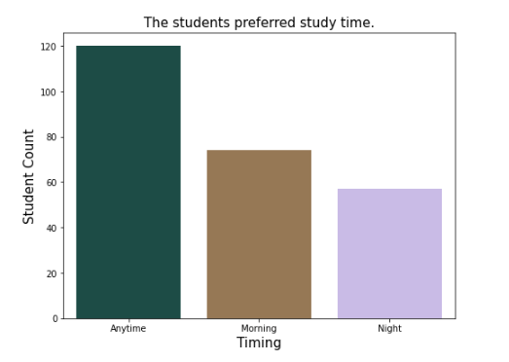
When would students like to study?
Overall, The student's preferred study time
According to the data above, most student prefer t0 study in Anytime.

Slide 24
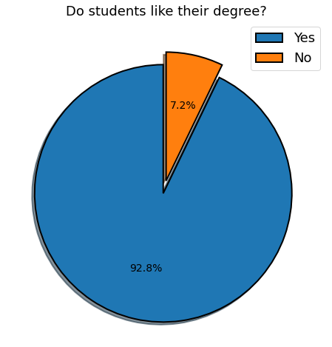
Do students enjoy graduating?
According to the above data, more then 90% of student like their degree.

Slide 25


